Slide 1
Inventory Forecasting and Analytics for Tata motors company – A case study for one Dealership Proposal Presentation
REVA Academy for Corporate Excellence (RACE)
Name: THANISH SHEKAR
Program: MSc in Business Analytics
Batch: BA11
SRN: R22MSB07
Date: 23/11/24
Capstone 1/2: 1
race.reva.edu.in

Slide 2
Agenda
01
Introduction
05
Project Methodology
Background | Current status | Why this study
Conceptual Framework | Research Design
02
Literature Review
06
Proposed Solution
Seminal works | Summary | Research Gap
03
Problem Statement
07
Detailed Scope of Work
Technical/Functional Problem
08
References
04
Project Objectives
Journal Articles | White Papers
Primary & Secondary Objectives | Expected Outcome

Slide 3

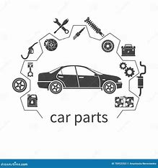
Background Information
Background | Current status | Why this study
Leading automotive manufacturer with a global presence.
Critical need for effective inventory management to meet customer demands.
Tata Motors, like other industry players, faces several key challenges in inventory management:
Stockouts, which can lead to missed sales opportunities and impact customer satisfaction.
Excess inventory, contributing to increased carrying costs and potential obsolescence.
Long lead times, which limit the ability to respond swiftly to changing market demands.
Inefficient order fulfillment, impacting operational efficiency and customer experience.

Slide 4
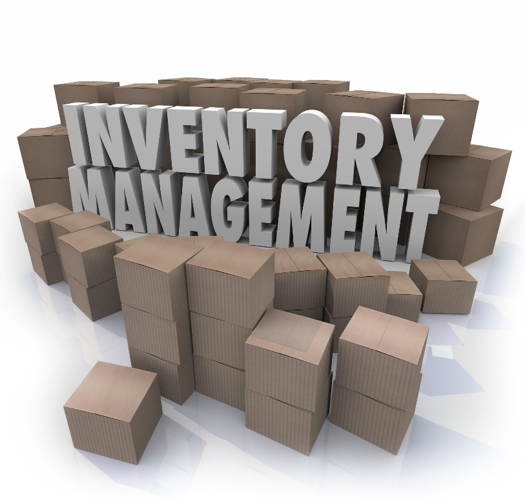
Background Information
Background | Current status | Why this study
Need for the Study:
Using the power of data analytics and predictive modeling, We can help the Tata motors Dealership to significantly enhance its demand forecasting capabilities and have a platform to make it efficient.
The following benefits can be derived:
Enhanced Demand Forecasting
Optimized Inventory Management
Minimized Carrying Costs
Improved Customer Satisfaction

Slide 5
Literature Review
Seminal works | Summary | Research Gap
No. | Title | Author and Year | Journal | Insights | Research Gaps/Comments
1 | Large-Scale Optimization in Online-Retail Inventory Management | Annie I-An Chen S.M., Massachusetts Institute of Technology (2017) | MIT | strategically lengthen the lead times of some fulfillment centers to create staggering. demand variability and per-unit overage or underage cost parameters have a nonlinear effect on the overall cost.
2 | Inventory – forecasting: Mind the gap | Thanos E. Goltsos, Aris A. Syntetos, Christoph H. Glock, George Ioannou | European Journal of Operational Research | forecast as the (best possible) genuine expectation of how much demand is going to be for a particular SKU Various manipulating characteristics of demand, in pursuit of inventory and ultimately supply chain efficiencies.

Slide 6
Literature Review
Seminal works | Summary | Research Gap
No. | Title | Author and Year | Journal | Insights | Research Gaps/Comments
3 | Forecasting inventory for the state-wide pharmaceutical service of South Australia | Rachel Rushton et al. (2022) | ScienceDirect | Forecasting inventory for pharma services using data science and modeling techniques Holt Winters Seasonal Additive + Damping model produced better predictions | The training conducted using only one year of data which is short.
4 | Method for data inventory and classification | Melina Masmann et al. (2020) | ScienceDirect | Data driven product planning within manufacturing companies This study focused on providing structural framework for data driven inventory in product planning | This framework is limited to only framework and not its implementation. Further explore to implement this framework

Slide 7

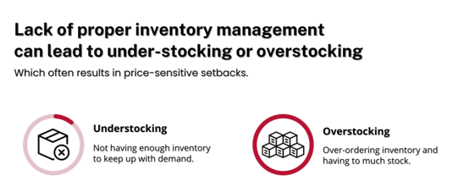

Problem Statement
Technical/Functional Problem
Challenge: The inability to predict future demand accurately, leading to either overstocking or stockouts, which impacts both operational costs and customer satisfaction.
Revenue
Customer Dissatisfaction

Slide 8
Project Objectives
Primary & Secondary Objectives | Expected Outcome
Primary Objective: Ensure that dealerships can maintain optimal inventory levels, reduce holding costs, minimize stockouts, and improve overall customer service by having the right parts available at the right time.
Objective 1: Automate the data movement using an ETL tool and integrating to Azure
Objective 2: Develop a Historic Dashboard using Power BI for analysis of metrics and Dimensions
Objective 3: Build a demand prediction model to forecast the demand for spare parts and components over the next 2 to 3 months.
Objective 4: Develop a dashboard to recommend actionable insights to business stakeholders based on current data.

Slide 9
Tech Stack
Conceptual Framework | Research Design
To achieve the Goals, we need:
Tata motors Dealership Transactional Data
Azure Cloud platform
Business Understanding
Data Understanding
Modeling
Tech Stack Involved:
Data Bricks
Data Factory
Azure SQL
PowerBI
Machine Learning
CI/CD

Slide 10
Tech Stack
Transaction Data
+
Customer Feedback
Business Understanding
Data understanding
Conceptual Framework | Research Design
Modelling
Azure Cloud Platform
ADLS
Data Factory
Azure SQL
PowerBI
DataBricks
GitHub

Slide 11
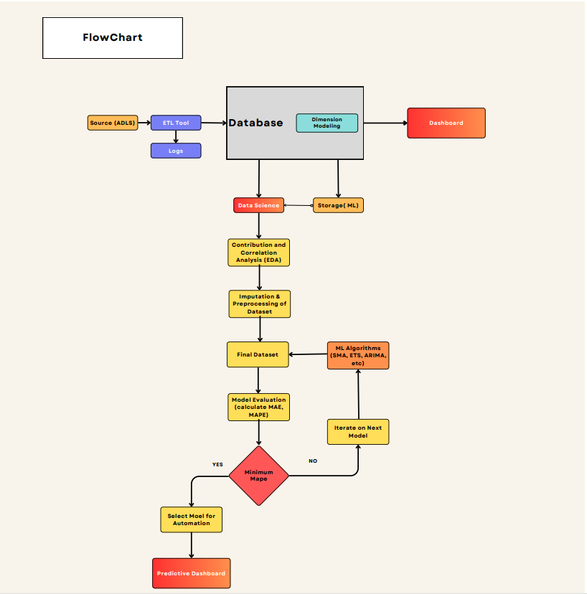
Project Methodology
Conceptual Framework | Research Design
Flowchart.pdf

Slide 12
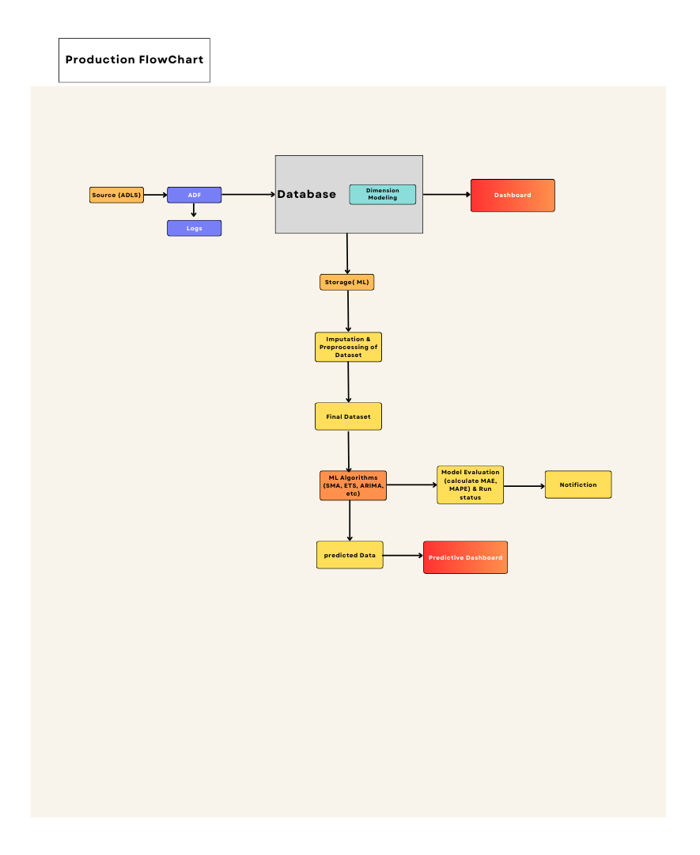
Production Deployment Method
Conceptual Framework | Research Design
Flowchart.pdf

Slide 13
Proposed Solution
Inventory Management Platform
Components of the Solution:
Data collection and Integration
Automating the Data streamline
Historical Dashboard & Predictive Dashboard
Model Implementation and Deployment
Monitoring and Continuous Improvement
Benefit to Business:
Improved Inventory Management
Cost Savings
Enhanced Customer Satisfaction
Increased Operational Efficiency

Slide 14
References
Journal Articles | White Papers
Inventory – forecasting: Mind the gap Thanos E. Goltsos a , Aris A. Syntetos a,∗ , Christoph H. Glock b , George Ioannouc , Inventory – forecasting: Mind the gap – ScienceDirect
Fildes, R., Ma, S., & Kolassa, S. (2020). Retail forecasting: Research and practice. International Journal of Forecasting. h

Slide 15


